Slide 1
Final Report 2020-2021
Enrollment & Admissions Policy Committee
April 7, 2021
Yakov Bart (DMSB)
Kelsey Kaul (COE)
Ann McDonald (CAMD)
Robert Painter (Chair, COS)
Jane Saczynski (BCHS)
David Smith (Khoury)

Slide 2
1. Overview of EAPC Charges 2020-2021
(1) The EAPC shall (a) review the experience of Academic Advisors for combined majors and specialty degree programs, particularly with a view to advising the Fall 2020 student cohort, and (b) report on current challenges to Advising across all colleges for combined majors and make recommendations for improvement. EXPLORED IN DEPTH
(2) In collaboration with the Registrar’s Office and other appropriate groups, the EAPC shall review the impact of the COVID-19 pandemic on the cohort of newly admitted undergraduate students, particularly analyzing the relevant questions in Fall 2020 TRACE evaluations, and recommend improvements to remote and hybrid instruction.
(3) In collaboration with the Office of the Provost and the Chancellor, the EAPC shall (a) review admission standards for MS programs across colleges, (b) analyze performance differences, as measured by letter grades, between BS, MS, and PhD students in courses where the three groups are mixed, and (c) provide recommendations on best practices to improve learning outcomes for students at all levels for these courses.

Slide 3
1. Overview of EAPC Charges 2020-2021
(1) The EAPC shall (a) review the experience of Academic Advisors for combined majors and specialty degree programs, particularly with a view to advising the Fall 2020 student cohort, and (b) report on current challenges to Advising across all colleges for combined majors and make recommendations for improvement. EXPLORED IN DEPTH
(2) In collaboration with the Registrar’s Office and other appropriate groups, the EAPC shall review the impact of the COVID-19 pandemic on the cohort of newly admitted undergraduate students, particularly analyzing the relevant questions in Fall 2020 TRACE evaluations, and recommend improvements to remote and hybrid instruction. OVERTAKEN BY EVENTS
(3) In collaboration with the Office of the Provost and the Chancellor, the EAPC shall (a) review admission standards for MS programs across colleges, (b) analyze performance differences, as measured by letter grades, between BS, MS, and PhD students in courses where the three groups are mixed, and (c) provide recommendations on best practices to improve learning outcomes for students at all levels for these courses.

Slide 4
1. Overview of EAPC Charges 2020-2021
(1) The EAPC shall (a) review the experience of Academic Advisors for combined majors and specialty degree programs, particularly with a view to advising the Fall 2020 student cohort, and (b) report on current challenges to Advising across all colleges for combined majors and make recommendations for improvement. EXPLORED IN DEPTH
(2) In collaboration with the Registrar’s Office and other appropriate groups, the EAPC shall review the impact of the COVID-19 pandemic on the cohort of newly admitted undergraduate students, particularly analyzing the relevant questions in Fall 2020 TRACE evaluations, and recommend improvements to remote and hybrid instruction. OVERTAKEN BY EVENTS
(3) In collaboration with the Office of the Provost and the Chancellor, the EAPC shall (a) review admission standards for MS programs across colleges, (b) analyze performance differences, as measured by letter grades, between BS, MS, and PhD students in courses where the three groups are mixed, and (c) provide recommendations on best practices to improve learning outcomes for students at all levels for these courses. NOT ADDRESSED – RECOMMENDED FOR 2021-2022 EAPC

Slide 5
2. Academic Advising
Bouvé College of Health Sciences
Lance Faria, Academic Advisor, Enrollment Management & Student Services
Olivia Grauel, Associate Director of Advising (Bouvé)
Yaneli Townsend, Academic Advisor, Enrollment Management & Student Services
College of Arts, Media and Design
Alison Ottaviano, Director of Advising (CAMD)
College of Engineering
Candace Martel, Assistant Dean, Undergraduate Advising (COE)
College of Science
Danielle Robert-Massey, Assistant Director of Academic Advising (COS)
Amber Watson, Director of Undergraduate Advising (COS)
College of Social Science & Humanities
Andy Casasanto-Ferarro, Director of Advising (CSSH)
Jason Ricco, Associate Director of Advising (CSSH)
D'Amore-McKim School of Business
Caitlyn Eaton, Assistant Director, Undergraduate Advising (DMSB)
Lauren Parker, Assistant Director, First Year Programs & Yield (DMSB)
Khoury College of Computer Science
Ali Ressing, Associate Director of Academic Advising (Khoury) and the Khoury Advising Staff: Jessica Biron, Beth Callahan, Megan Clough Groshek,
Jill Forgash, Jake Goldblum, Connor Guerin, Prajna Kulkarni, Karyn Rosen, Jessica Speece, Dawn Shirak, Claire Wassinger
EAPC conducted one-on-one and group interviews with advisors across the University to learn about:
advising in Fall 2020 during the on-going pandemic
advising to an increasing number of combined majors
issues and concerns about the system of advising in various Colleges

Slide 6
2. Academic Advising
Bouvé College of Health Sciences
Lance Faria, Academic Advisor, Enrollment Management & Student Services
Olivia Grauel, Associate Director of Advising (Bouvé)
Yaneli Townsend, Academic Advisor, Enrollment Management & Student Services
College of Arts, Media and Design
Alison Ottaviano, Director of Advising (CAMD)
College of Engineering
Candace Martel, Assistant Dean, Undergraduate Advising (COE)
College of Science
Danielle Robert-Massey, Assistant Director of Academic Advising (COS)
Amber Watson, Director of Undergraduate Advising (COS)
College of Social Science & Humanities
Andy Casasanto-Ferarro, Director of Advising (CSSH)
Jason Ricco, Associate Director of Advising (CSSH)
D'Amore-McKim School of Business
Caitlyn Eaton, Assistant Director, Undergraduate Advising (DMSB)
Lauren Parker, Assistant Director, First Year Programs & Yield (DMSB)
Khoury College of Computer Science
Ali Ressing, Associate Director of Academic Advising (Khoury) and the Khoury Advising Staff: Jessica Biron, Beth Callahan, Megan Clough Groshek,
Jill Forgash, Jake Goldblum, Connor Guerin, Prajna Kulkarni, Karyn Rosen, Jessica Speece, Dawn Shirak, Claire Wassinger
We would like to thank all advising staff for their time, help, and professionalism.

Slide 7
2.1 Findings: Fall 2020 worked well…
Advising the Fall 2020 cohort worked well due to adaptive use of virtual individual, and group advising, and drop-in hours.
Students with ‘emergent’ issues like to connect to advisors instantly in a virtual space.
“No-show rates and cancellation rates [for appointments] are much lower, because students are enjoying ease of access, and they prefer it that way.” (Bouvé)
“CS students are going to want virtual advising appointments forever.” (Khoury)

Slide 8
2.1 Findings: Fall 2020 worked well…
Very few problems with the new medium:
NUStart, NU-In Boston created an influx of extra students on advisors on Fall 2020.
‘Zoom burnout’ made it harder for students to join optional evening information sessions or departmental events; lower student attendance at “extras”.

Slide 9
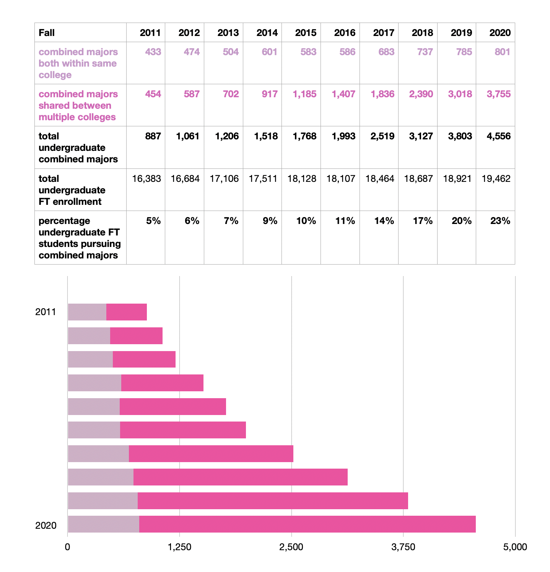
2.2 Combined majors present a challenge to Advisors…
The exponential growth in combined-major enrollment is largely an unrecognized change in the advisors’ workload.
The ~159 combined major programs, independent combined majors, and PlusOnes present a challenge for advisors, depending on College.

Slide 10
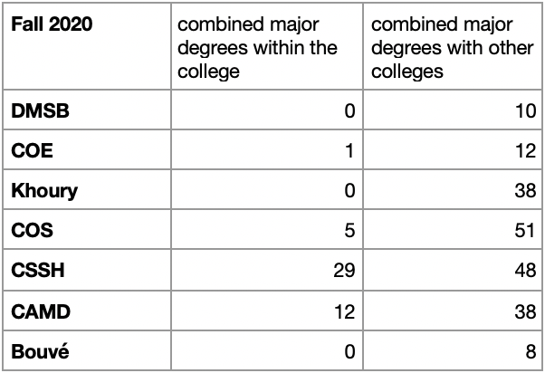
2.2 Combined majors present a challenge to Advisors…
Bouvé, COE, Khoury, DMSB advisors have a relatively easy time, due to small(er) numbers of programs or ‘home college’ advantages.
“Three combined majors are primary; we’re only talking 50 or so students” (Bouvé)
“There’s very little room for outside course choice, so there isn’t a problem” (COE)

Slide 11
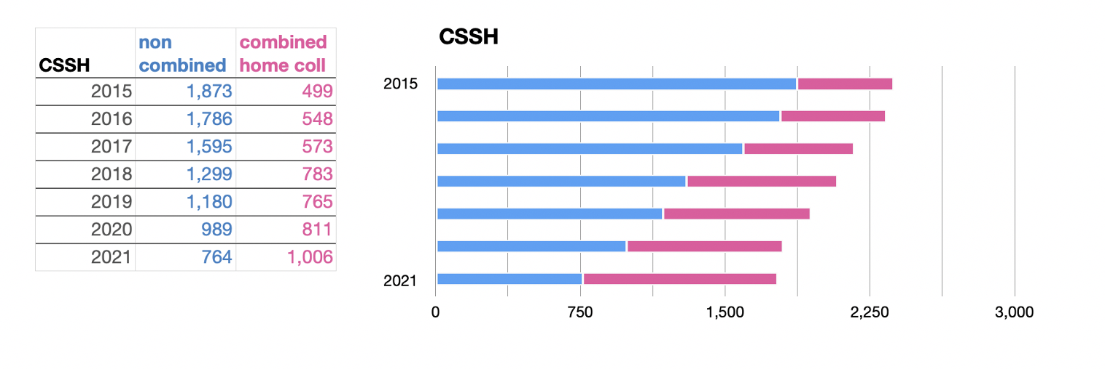
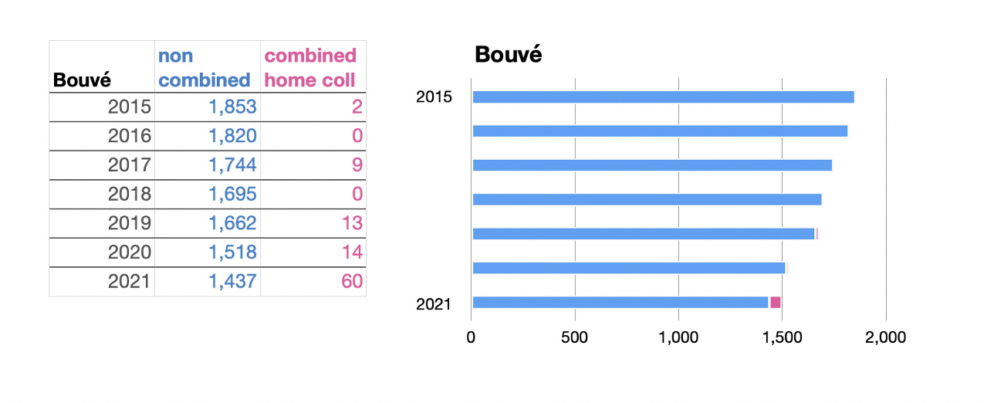
2.2 Combined majors present a challenge to Advisors…
CAMD, CSSH, and COS advisors have a harder time advising students.
“It’s hard for advisors to be experts in all the majors they advise. Advisors cannot keep up on it all....” (COS)
“The University is so complex, there are so many options for students... I don’t think advising is sustainable as it is, with the flexible student path narrative NU is presenting.” (CAMD)

Slide 12
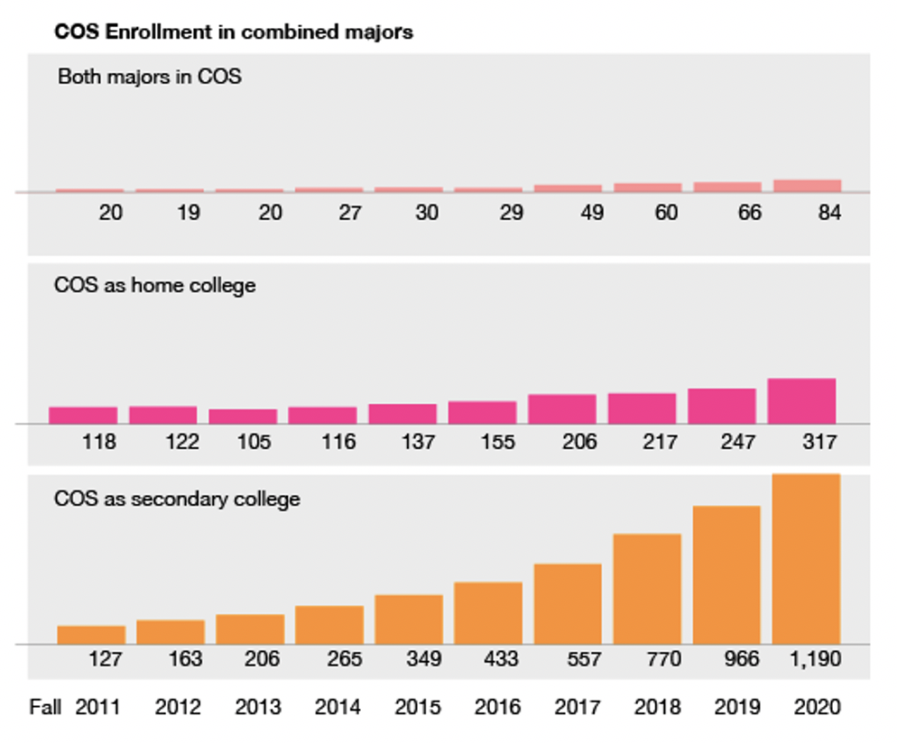
2.3 ‘Home college’ issue to be investigated…
Students often have the choice of which side of a major is the home college for advising purposes. Various problems arise:
CAMD, COS, CSSH have “hidden work” in their caseloads, e.g. advisors do extra advising for students housed in other colleges.
Students game the system in various ways, for NU-In sites, co-op cycles, degrees on diplomas.

Slide 13
2.3 ‘Home college’ issue to be investigated…
The ‘home college’ issue plays out in student-advising experiences being inconsistent and adversely in advisor workload across units.
We make a recommendation below that SAC assign next year’s EAPC a charge to investigate the impact of home college choice on students and advisors at Northeastern.

Slide 14
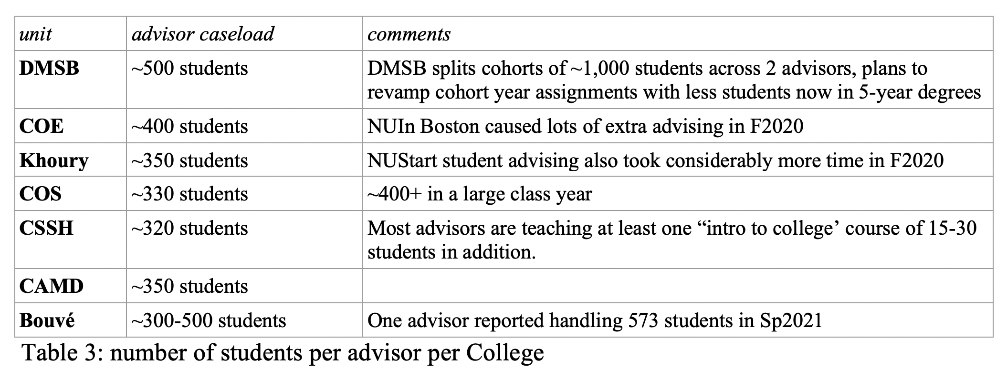
2.4 Advisors’ caseloads are too high…
NU Advisors have large, unmanageable caseloads, along with teaching responsibilities and peer-mentoring roles.
National Association of College Academic Advisors (NACADA) recommends that advisors should handle no more than ~250 students per advisor.
Every NU advising unit exceeds the recommendation.

Slide 15
2.4 Advisors’ caseloads are too high…
COS advisors are handling ~330 students, plus teach 3 sections of e.g. BIO 1000 or LING 1000 with 19+ students.
Units such as CSSH have had explicit discussions with about expected hours of staff because advisors are working to the point of burnout.

Slide 16
2.4 Advisors’ caseloads are too high…
Advisors reported high caseloads result in poorer quality advising:
“If we had more staff, I could give more proactive advising rather than reactionary advising” (Bouvé)
“Students want personal relationships with advisors, but they cannot get it” (CAMD)

Slide 17
2.4 Advisors’ caseloads are too high…
Most College advising teams are manifestly understaffed by at least 1-2 advisors.
The EAPC heard numerous off-the-record reports that leaderership was non-receptive to concerns about the increased number of students-per-advisor or the issue of advisor burn-out.
“We send these concerns up the chain, but the issues are sent back down with the ‘Just deal with it’ line... Advisors feel powerless.” (unit redacted)
“Over-enrollment is killing us.” (unit redacted)

Slide 18
2.5 Advisors are drawn into a mental-health triage role…
There was a consensus that the University does not understand the expanded role which advisors play in being ‘point person’ for students with mental health issues.
“Advisors are not counselors, but our referrals to WeCare are turned back to us” (Bouvé)
“The burden is on the advisor who may or may not be trained for this” (COS)
“We’ve been dealing with more mental health issues, financial health issues… talk about food insecurity, homelessness… factors which are not strictly in the academic area are on the rise” (CSSH)

Slide 19
2.5 Advisors are drawn into a mental-health triage role…
If a student is ‘in crisis’, there is an expectation among faculty and administration that advisors should be the main contact person to gather the “totality of the situation.”
At a given time, an advisor is working at least 5 very serious situations; and another 10 students who might end up on medical leave.
Advisors are getting 100+ “red” FACT warnings during peak times.
We recommend (much) better staffing at WeCare and UHS to unweight the advisors’ ersatz role as health care provider.

Slide 20
2.6 Advising needs a better computational toolkit
Advisors reported the current academic technology was unhelpful for long-range planning of student careers in respect to co-op cycles, DOC and study abroad, PlusOne and other degree options.
Advisors are routinely logged into, e.g. Banner, Salesforce, DARS, Navigate… there are too many platforms, and they are unintegrated with one another.
“An online individual student planning tool will allow advisors to be less transactional and more developmental.” (Khoury)
“We support 100% an online student plan that could be shared across advisors, students, and faculty mentors.” (CAMD)

Slide 21
3. Recommendations on Advising Charge
(1) The Committee recommends that the SAC charge the 2021-2022 EAPC with investigating the issue of ‘home college’ on student planning in combined-majors, challenges to academic advising, communication with faculty mentors, and preparation for co-op, NU-In, study abroad, and Dialogue programs.

Slide 22
3. Recommendations on Advising Charge
(2) The Committee recommends that the Academic Advisory Group and Deans to review and adopt practices where a student is assigned two advisors, one for each side of a combined-major, so that they have access to advisors for both areas of their degree.

Slide 23
3. Recommendations on Advising Charge
(3) The Committee recommends that Provost’s Office report to the Faculty Senate on progress in procuring an updated online platform for individual student plans for student, advisor, and faculty mentors (as moved in EAPC 2018-19 1st Resolution).

Slide 24
3. Recommendations on Advising Charge
(4) The Committee strongly recommends that the Provost allow for hiring of new advisors, and the leadership actively aim for a standard workload of advisors across the University to be capped at ~250 students per advisor, so that advising is less transactional and more interpersonal.

Slide 25
3. Recommendations on Advising Charge
(5) Recommend immediate increase in WeCare hiring and establishing clear and transparent procedures for advisors to refer students to WeCare, so that advisors are not drawn into ad-hoc mental health counseling roles.

Slide 26
4. Proposed Resolutions
WHEREAS advisor caseloads across the University far outstrip national averages in higher education, and whereas the workload is unsustainable due to overwhelming range of responsibilities including advising large number of students, teaching courses, managing peer-mentor programs, and increasingly getting forced to triage mental health concerns, and whereas advisors are looking to more developmental, proactive advising to students...
BE IT RESOLVED that the Senate recommend that the Office of the Provost allow for the immediate hiring of new advisors in Advising units with a goal that the average workload for Advisors at the University does not exceed 250 students to meet with NACADA recommendations.

Slide 27
4. Proposed Resolutions
WHEREAS the ongoing COVID-19 pandemic presents an unparalleled circumstance which affects student mental health, and whereas advisors are increasingly forced to deal with emergent issues among students, and whereas holistic success of students is paramount.
BE IT RESOLVED that the Senate recommend that the Provost Office review available staffing vis-a-vis student demand for mental health services at WeCare, NU Find, UHS, and if needed, make immediately available further counselors to satisfy unmet demand among the growing student community across Northeastern University campuses, to unweight these roles from advisors.

