Slide 1
Financial Affairs Committee Charge 1
January 18, 2023

Slide 2
Financial Affairs Committee (FAC)
Deb Copeland, Chair, BCHS - SOPPS
Sumner Barenberg, COE - Bioengineering
Apoo Koticha, DMSB - Finance Group
Joseph McNabb, CPS - Graduate Programs
Srinivas Sridhar, COS - Physics
Gary Young, BCHS/DMSB – International Business & Strategy

Slide 3
Charge 1
From the Senate Agenda Committee to the 2022/23 Financial Affairs Committee (FAC) includes:
Considering increases in the cost of living, on or before December 5, 2022, the committee shall:
Examine the total faculty compensation.
Review match-mate institution data and compare salary raises.
Make recommendations for 2023 merit raises for full time faculty.
Identify alternative compensation strategies, to fill the cost-of-living gap, in the absence of direct financial increase (e.g., pay out vacation time or roll over of vacation time, exemplary employee compensation (e.g., referral for a job well done)).

Slide 4
a. Examine the total faculty compensation
Compensation Module within the Faculty Handbook describes merit is connected to teaching, scholarship and service
Compensation = initial salary + merit + equity (when applicable) + non-financial compensation
Merit is NOT intended to account for cost-of-living (COL) increases (COLI)
However, nationally, COL has been on the rise since the height of the pandemic

Slide 5
Table 1—FAC report
Social Security Administration COLA (Cost of Living Adjustments)
Source: https://www.ssa.gov/oact/cola/colaseries.html
 | 2018 | 2019 | 2020 | 2021 | 2022
COLA | 2.8 | 1.6 | 1.3 | 5.9 | 8.7
The Social Security Administration (SSA), in conjunction with the federal government has reported an 8.7% cost of living adjustment (COLA) for payments to retirees effective December 2022
highest increase in 40 years

Slide 6
b. Review match-mate institution data & compare salary

Slide 7
Table 2 of FAC Report US News and World Report Rankings (USNWR)
University | *2023 | 2022 | 2021 | 2020
Boston College | 36 | 36 | 35 | 37
Boston University | 41 | 42 | 42 | 40
Brandeis | 44 | 42 | 42 | 40
Carnegie-Mellon University | 22 | 25 | 26 | 25
George Washington University | 62 | 63 | 66 | 70
Lehigh University | 51 | 49 | 49 | 50
New York University | 25 | 28 | 30 | 29
Northeastern University | 44 | 49 | 49 | 40
Notre Dame University | 18 | 19 | 19 | 15
Rensselaer Polytechnic Institute | 51 | 55 | 53 | 50
Rice University | 15 | 17 | 16 | 17
Southern Methodist University | 72 | 68 | 66 | 64
Syracuse University | 62 | 59 | 58 | 54
Tufts | 32 | 28 | 30 | 29
Tulane University | 44 | 42 | 41 | 40
University of Miami | 55 | 55 | 49 | 57
Wake Forest University | 29 | 28 | 28 | 27
(*Source: https://www.usnews.com/best-colleges/rankings/national-universities)

Slide 8
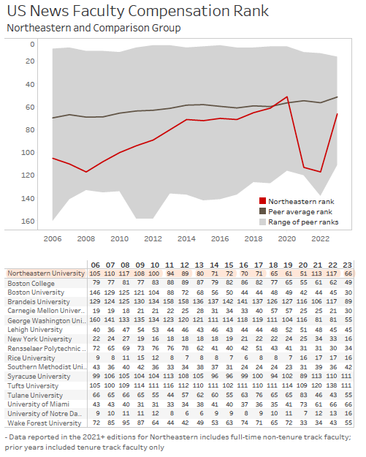
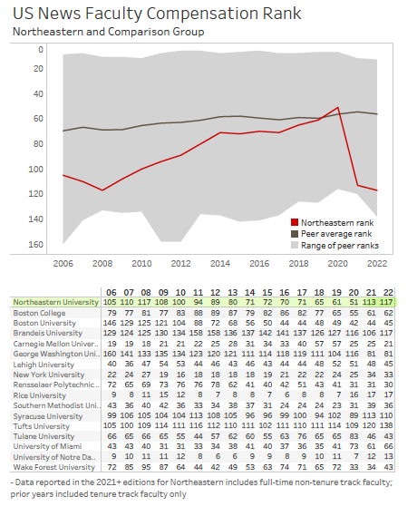
Figure/Table 3a FAC Report US News and World Report Faculty Compensation Ranking
2022 - 2023
2021 - 2022

Slide 9
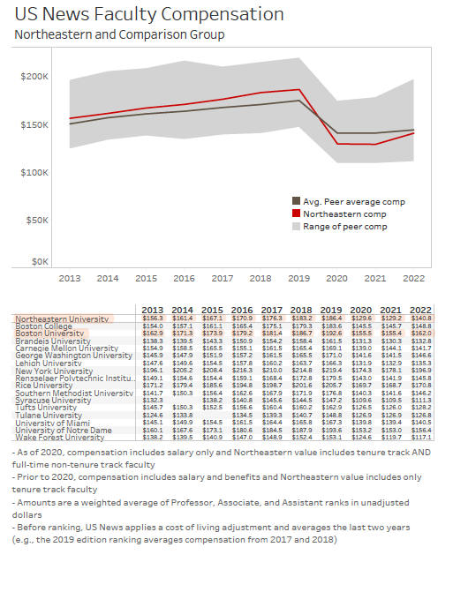
Table 3b of FAC Report

Slide 10
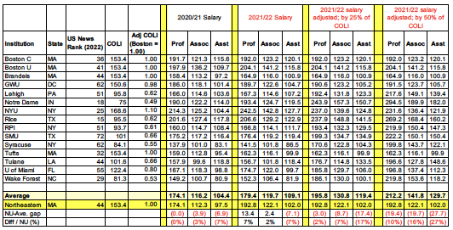
Table 4a AAUP Faculty Compensation Survey Summary
COLI from bestplaces.net

Slide 11
Table 4b of FAC Report AAUP Faculty Compensation Survey – Only Boston University

Slide 12
Table 5 Net Operating Surplus (Increase in net assets from operating activities)
 | FY 2017 | FY 2018 | FY 2019 | FY 2020 | FY 2021 | FY 2022
Net Operating Surplus | $66,315,000 | $107,580,000 | $135,715,000 | $184,572,000 | $116,850,000 | $151,714,000
Annual Increase |  | 62% | 26% | 36% | -37% | 30%
5y Compounded Increase |  |  |  |  |  | 18%

Slide 13
c. Make recommendations for 2023 merit raises for full time faculty
BE IT RESOLVED that the recommended raise pool for merit for FY 2024 be 8.7%, at a minimum, of continuing salaries starting on July 1, 2023

Slide 14
d. Identify alternative compensation strategies, to fill the cost-of-living gap, in the absence of direct financial increase (e.g., pay out vacation time or roll over vacation time, exemplary employee compensation (e.g., referral for a job well done)).

Slide 15
Charge 1, part d
NON-SALARY COMPENSATION ITEMS OF GREATEST CONCERN
Senate Faculty Affairs Committee 12-12-2022
2 SURVEYS CONDUCTED
Senate Faculty survey 2022 (434 respondents to FAC questions)
Staff /Fac Watercooler survey 2022 on commuting and transportation (>520 responses, >268 written comments)
KEY DRIVERS
Cost of living increased dramatically
Change in work schedules (e.g. hybrid)
Transportation / parking options do not address current needs
Remedies need to be progressive: i.e. most benefit to the lower compensated employees
TOP LEVEL (CRISIS) REQUESTS
SUBSIDIES FOR PUBLIC TRANSPORTATION (18.3%)
Partial or full subsidies for T-pass or commuter rail (provided by MIT & BU)
FLEXIBLE PARKING OPTIONS (18.26%)
Credit card and hourly parking
Short-term (not annual) parking options
Subsidized daily rates
PROVIDE “COUPONS” FOR (a) Childcare (12.63%) (b) Adult care (7.09%)
ONE TIME PERFORMANCE BONUS (13.2%)
OTHER REQUESTS:
Housing subsidies
Improved retirement options and education

